Slide 1


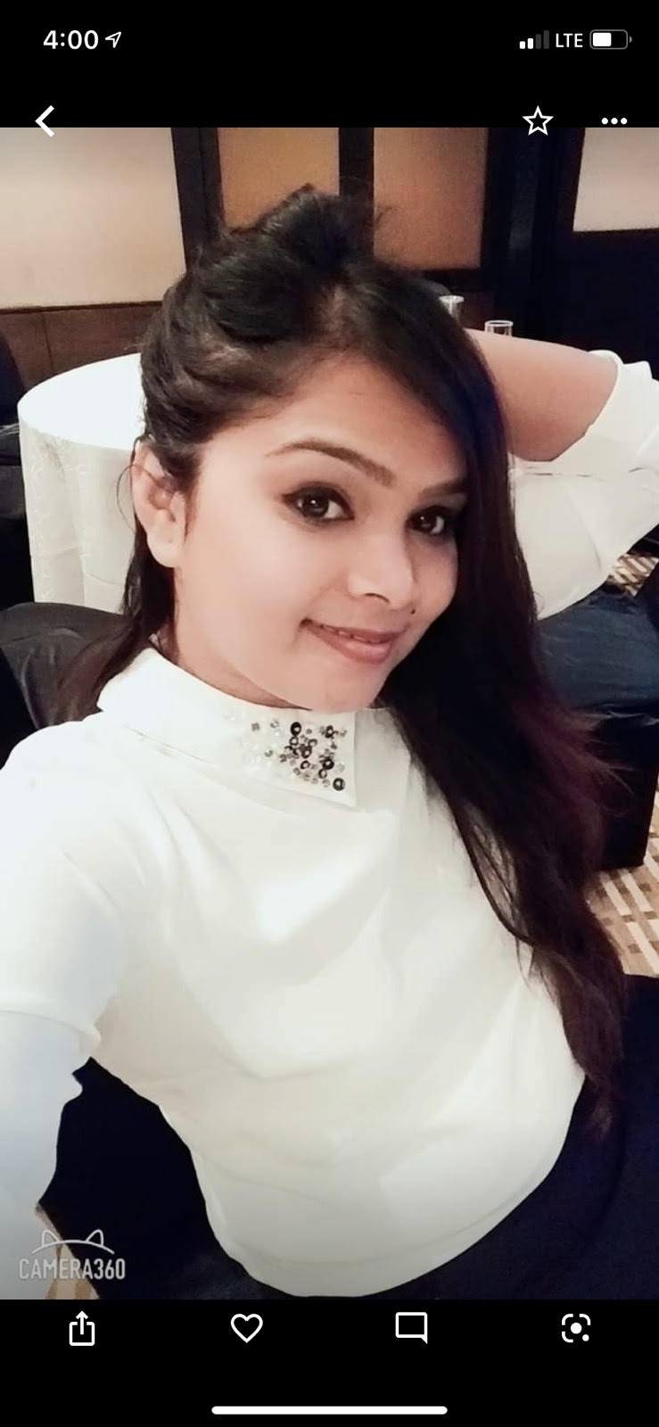

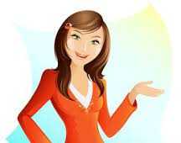

Who Am I ?
All about Myself
I am Sweta chaurasiya
Born and bought up in different places with different culture, My Dad is servicing as warrent officer in Indian Airforce,Recently got married to software engineer . I am basically from Bihar and Samastipur is my home-town.
Notes:
1

Slide 2
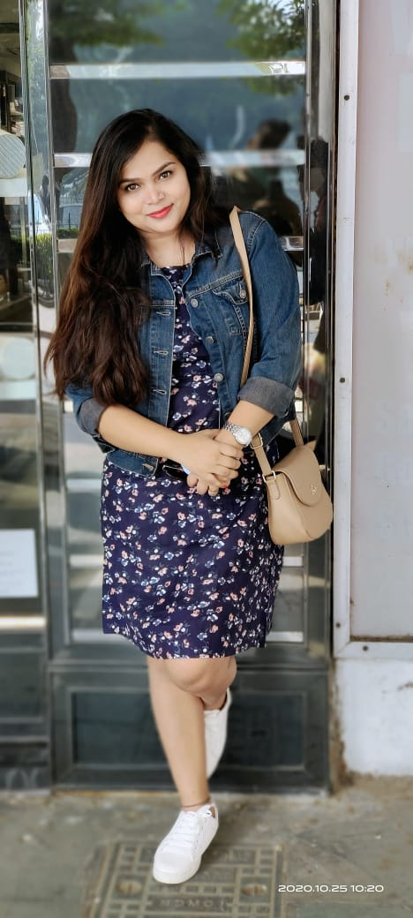



Qualification and experience
Bio Data
Bio data
I am Sweta Chaurasiya
Birthplace – Bettiah, Bihar
Family and relatives call me – Sonu ,Soni
Born- 15/12/1991
Father – Nagendra Prasad ( Flying Officer, Indian Air Force)
Mother – Gayatri Devi ( Home Maker)
I have completed my Graduation from Maharani laxmi Ammani college bangalore with the course Bachlor of Arts.
Completed post-Graduation from Bangalore university with course MSC.Psychology in 2015
I have completed my Schooling from Kendriya- vidyalaya chandigarh.
Notes:
2

Slide 3







Experience
Qualification and Experience
10th : Kendriya Vidyalaya Chandigarh (2008).
12th : Kendriya Vidyalaya Chandigarh (2010).
B.A (Psychology) : Maharani Laxmi Ammani college for women, Bangalore (2013).
M.Sc.(Psychology, Child Specialist) : Bangalore University (2015).
I have worked as Sr.Academic counselore in HKBK college of engeneering.
I have worked for Phoenix global resettlement services with same designation and job.
.
Then i worked for AIMS-Acharya institutes management and science.
Then i worked for collegedekho.com.
Notes:
3

Slide 4

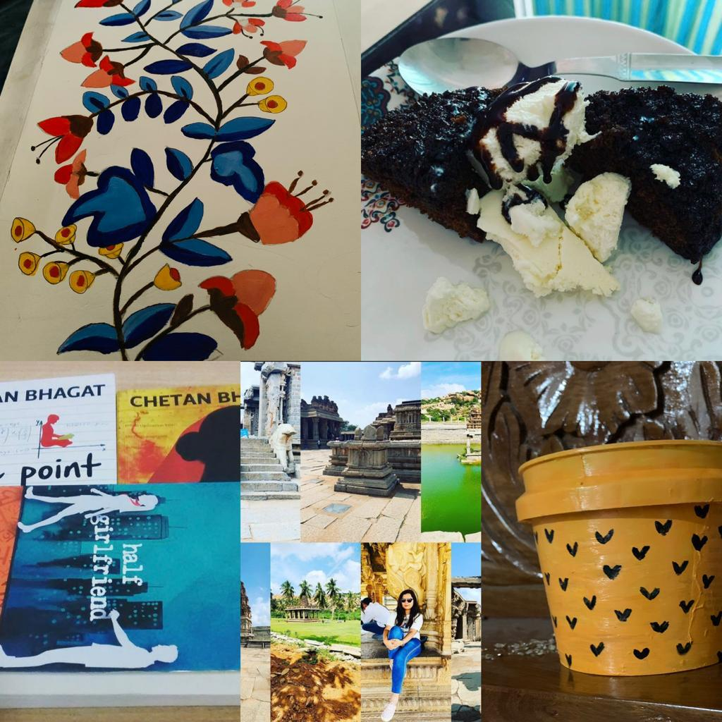
Hobbies
Experience
Experience
I have almost 4 years of working experience as an academic counselor with multiple organization.
I worked as a Sr. Academic counselor for HKBK college of engineering.
I had been part of Phoenix global resettlement services with same designation and job.
I worked for Acharya Institute Management and Science (AIMS).
The last organization collegedekho.com for which I worked till 2020.
Dancing
Reading Novels- Mostly Non fictions
Love playing Batminton
Love Cooking experiments.
Travelling scenery places.
Sometimes Drawing and crafting
Notes:
4

Slide 5

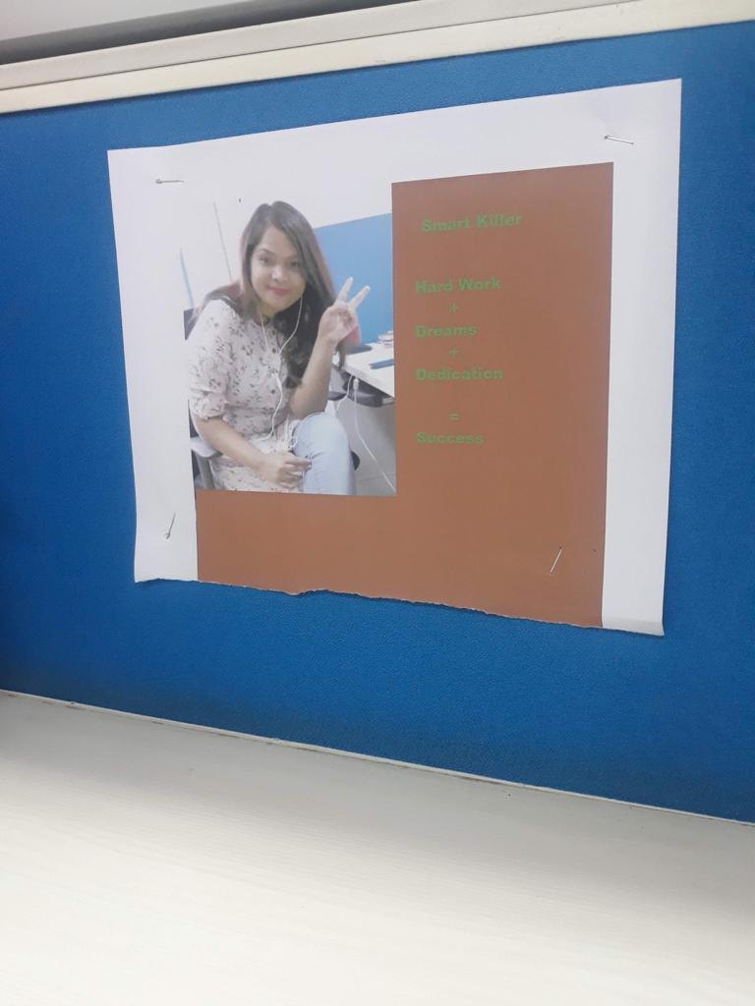
What others says about me...
Hobbies
Dancing.
Reading Novels- mostly nonfiction.
Love playing Badminton.
Love cooking experiments.
Travelling beautiful and adventurous places.
Drawing and crafting.
Hobbies
Friends -Genuine, thoughtful and motivator.-
Dr.Shikha Joshi (psychologist)
Loyal friendly and easy to talk with - Ayesha Ali (works in Nihmans)
Little aggresive -My mom
Hardworker ,Dreamer,polite,soft spoken
Dedicated ,sincere – (My junior colleagues)
Notes:
5

Slide 6

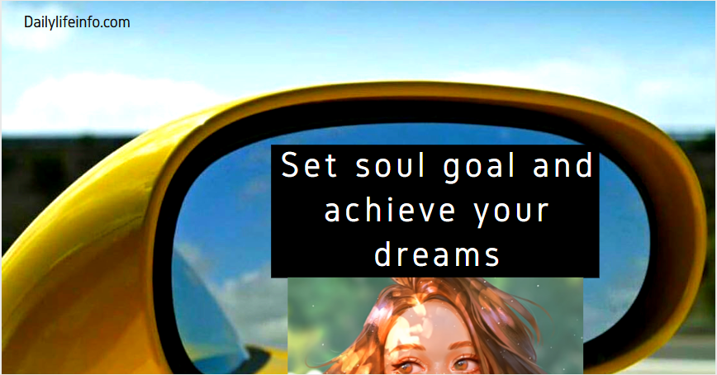
Dreams/Goals
What others say about me…..
Friends – Genuine, thoughtful and Motivator. –Dr. Shikha Joshi (Psychologist).
Loyal friend and easy to talk with – Ayesha Ali (Working for NIHMANS, Bangalore).
Little Aggressive – By Mom.
Hard worker , Dreamer, Polite , Softspoken, Dedicated , Sincere- ( My Junior colleagues).
Wish to work as HR manager in IT firm.
Want to remain financially independent forever.
Wish to have my own dream properties.
Wish to go for world tour.
Notes:
6

Slide 7

Dreams /Goals
Wish to work as an HR manager for a renowned MNC.
Want to remain financially independent forever.
Wish to have my own dream home of my own.
Wish to go for world tour.

Slide 8
Thank You…

